Slide 1

Topic 12: Big Data Privacy and Security
We will wait for 5 to 10 mins for everyone to join
Big Data and Analytics

Slide 2

What we discussed last week?
  Graph analytics
Big Data and Analytics

Slide 3
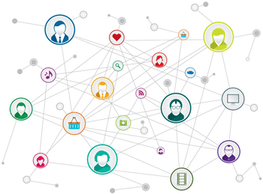
Definition: Graph analytics is a set of analytical techniques that allow for the exploration of relationships, patterns, and structures within
graph-based data.
graph analytics can uncover insights in large datasets where relationships are key, such as social networks, supply chains, and internet topology.
Big Data and Analytics

Slide 4
Simple (Undirected) Graph: consists of V, a nonempty set of vertices, and E, a set of unordered pairs of distinct elements of V called edges (undirected)
Representation Example: G(V, E), V = {u, v, w}, E = {{u, v}, {v, w},
{u, w}}
u
v
w
Big Data and Analytics

Slide 5
Directed Graph: G(V, E), set of vertices V, and set of Edges E,
that are ordered pair of elements of V (directed edges)
Representation Example: G(V, E), V = {u, v, w}, E = {(u, v), (v, w), (w, u)}
u
v
w
Big Data and Analytics

Slide 6
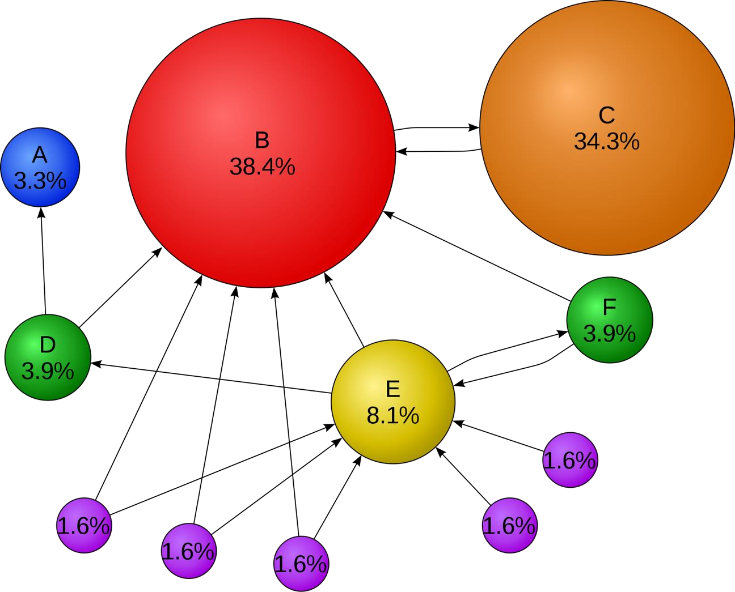
PageRank was created by Google’s founders Larry Page and Sergey Brin to rank web pages, treating the internet as a directed graph.
The goal is to identify the most central or interesting node within this graph, based on the intuition that a node is important if it’s connected to other important nodes.
The solution proposed is to employ
the random walk model, where the most popular nodes are those with
the highest steady-state probability (SSP).
Big Data and Analytics

Slide 7

Data Security
Data security is the practice of protecting digital information from unauthorized access, corruption or theft throughout its entire lifecycle.
It’s a concept that encompasses every aspect of information security from the physical security of hardware and storage devices to administrative and access controls, as well as the logical security of software applications. It also includes organizational policies and procedures.
When properly implemented, robust data security strategies will not only protect an organization’s information assets against cybercriminal activities, but they'll also guard against insider threats and human error, which remain among the leading causes of data breaches today.
Big Data and Analytics

Slide 8

Privacy: Protects personal data and determines who can access it
Security: Protects systems and data from attacks, ensuring how data is safeguarded
Both are interdependent but distinct concepts

Slide 9
Physical Security – protection of hardware and infrastructure
Network Security – firewalls, intrusion detection, secure connections
Application Security – secure coding, vulnerability testing
Data Encryption – securing data at rest and in transit
Operational Security – policies, user permissions, monitoring
End-user Security – training users against phishing/social engineering

Slide 10
Types of data security Encryption
Using an algorithm to transform normal text characters into an unreadable format, encryption keys scramble data so that only authorized users can read it. File and database encryption solutions serve as a final line of defense for sensitive volumes by obscuring their contents
through encryption or tokenization. Most solutions also include security key management capabilities.
Data masking
By masking data, organizations can allow teams to develop applications or train people using real data. It masks personally identifiable information (PII) where necessary so that development can occur in environments that are compliant.
Data resiliency
Resiliency is determined by how well an organization endures or recovers from any type of failure—from hardware problems to power shortages and other events that affect data availability. Speed of recovery is critical to minimize impact.
Data erasure
More secure than standard data wiping, data erasure uses software to completely overwrite data on any storage device. It verifies that the data is unrecoverable.
Big Data and Analytics

Slide 11
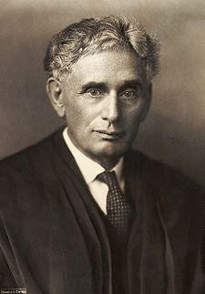

Louis Brandeis (1890)
–“right to be left alone”
–protection from institutional threat: government, press
Data privacy is the
protection of personal
data from those who
should not have access to it and the ability of individuals to determine
Alan Westin (1967)
– “right to control, edit, manage, and delete information about themselves and decide when, how, and to what extent information is communicated to others”
who can access their
personal information.
Big Data and Analytics

Slide 12


Tracking on the web
IP address
  Number identifying your computer on the Internet
  Visible to site you are visiting
  Not always permanent
Cookies
  Text stored on your computer by site
  Sent back to site by your browser
  Used to save prefs, shopping cart, etc.
  Can track you even if IP changes
Identity
  name,
  address
Location
Activity
  web history,
  contact history,
  online purchases
Health records
…and more
72.21.214.128
Internet
152.3.136.66
Big Data and Analytics

Slide 13
Data anonymization & pseudonymization
  Anonymization: Removing personal identifiers (e.g., names, IDs) so data cannot be linked to individuals.
  Pseudonymization: Replacing identifiers with artificial IDs (e.g., patient #12345 instead of name).
Encryption (at rest and in transit)
  Protects data at rest (stored) and in transit (when being transmitted).
  Advanced techniques: homomorphic encryption allows computations to be performed on encrypted data without decryption, keeping sensitive information hidden.
Differential privacy methods
  Adds controlled “noise” (randomness) to datasets or query results.
  Ensures that results remain statistically accurate but make it very difficult to trace data back to an individual.
  Example: Used by Apple and Google in their data collection.

Slide 14
Access Controls & Governance
  Role-based access: Users only see the data they are authorized to.
  Multi-factor authentication and logging of access activities.
  Essential for compliance with regulations like GDPR(European Union's General Data Protection Regulation).
Data Minimization
  Collect only the data that is strictly necessary.
  Reduces exposure and aligns with privacy laws.

Slide 15
Breach of personal data of ~147 million people (2017)
Cause: unpatched vulnerability
Consequences: identity theft, financial loss, reputational damage
Lesson: importance of timely updates and monitoring

Slide 16
https://cdnapisec.kaltura.com/html5/html5lib/v2.101/mwEmbedFrame.php/p/1282131/uiconf_id/4283396 2/entry_id/0_e8jrgx86?wid=_1282131&iframeembed=true&playerId=kaltura_player_1600412732&entry_i d=0_e8jrgx86
Big Data and Analytics
16

Slide 17


Big Data and Analytics
17

